Slide 1
Milestone 4: Final Presentation
Automation of Initech ITAM Process
Prof. Dr. Tatiana Walsh
April 24, 2022

Slide 2
Table of contents
Project Charter
Problem Statement
Technology Solution Statement
Project Benefits
Requirements
Business Functions
Serialized Asset Tracking: Major Functions, Process Maps
Stockroom Management: Major Functions, Process Maps
ITAM Process: Major Functions, Process Maps
Security Process: Major Functions, Process Maps
System Design
User Interface: mock-ups
Infrastructure Architecture: network diagram
Information Architecture: ERD
Security and Privacy Architecture: security risks with corresponding controls

Slide 3
PROJECT CHARTER

Slide 4
Problem Statement
According to the recent audit report, InTech Solutions is experiencing a problem with the present techniques for managing asset data which includes data duplication and mismanagement, visualization issues, and decentralized data models.

Slide 5
Technology Solution Statement
Our technology solution to address various issues that are identified in the recent audit report is to create an in-house IT asset management system.

Slide 6
Project Benefits
Dashboard: Greater visibility across the organization!
Consistent and unified Records: Consistent data, integration with external resources, continuous reporting feature.
Model Association and Asset Stage Identification: Best tracking strategy, no duplication of asset elements
Savings in time and money: Price reductions and upgraded features
Reduce Customer Complaints: Customers are the foundation of our company!!

Slide 7
REQUIREMENTS

Slide 8
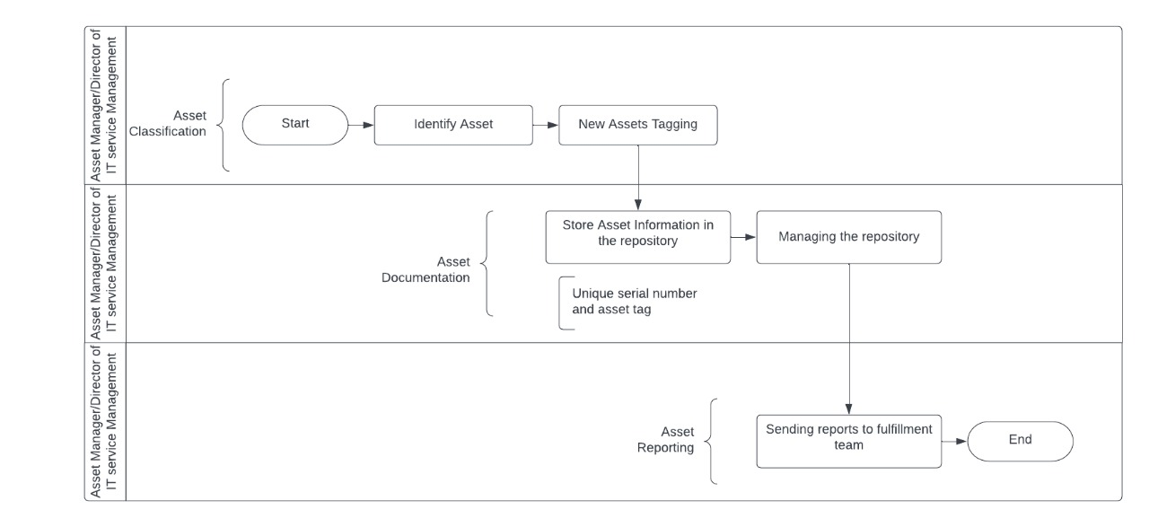
Business Function 1: Serialized Asset Tracking
Tracking key information such as asset maintenance, scheduling, expiration, and recycling is achieved with the computerized asset management system.
The businesses will gain complete asset visibility including location, status, and usage history, using a single web-based dashboard that enables quick search and tag filtering.
Fig.1

Slide 9
Business Function 2: Stockroom Management
Stockroom management will assist our company in knowing exactly where its products are, maintaining an accurate count of all items, and ensuring room for new orders.
A well-organized warehouse improves the efficiency of present and future fulfillment strategies.
This includes cost savings and improved product quality for companies that employ warehouses to manage inventories.
Fig.2

Slide 10
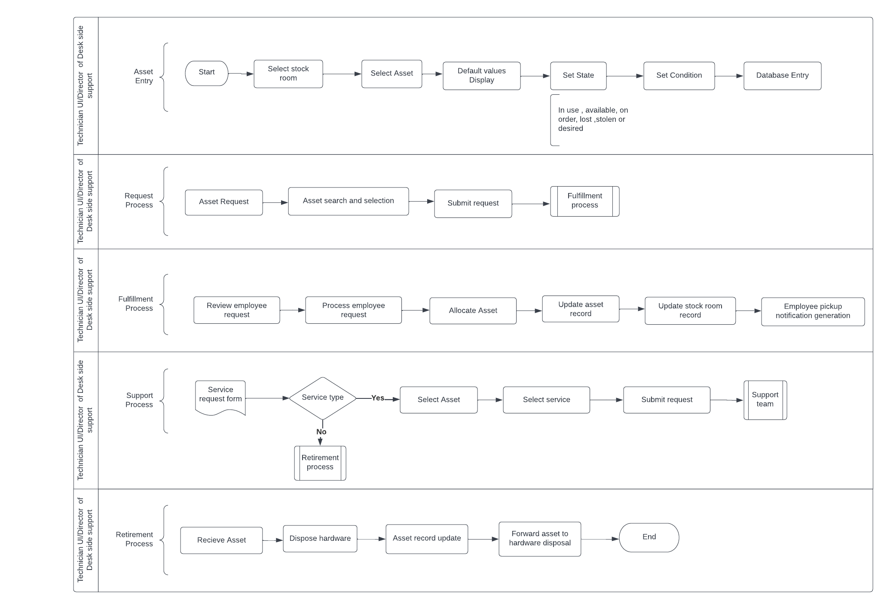
Business Function 3: ITAM Process
The request and fulfillment process is a management procedure that touches every other function since it requires data updates in the central repository once the request is reviewed by another team.
The functions are:
1. Asset entry
2. Request process
3. Fulfillment process
4. Support process
5. Retirement process
Fig.3

Slide 11
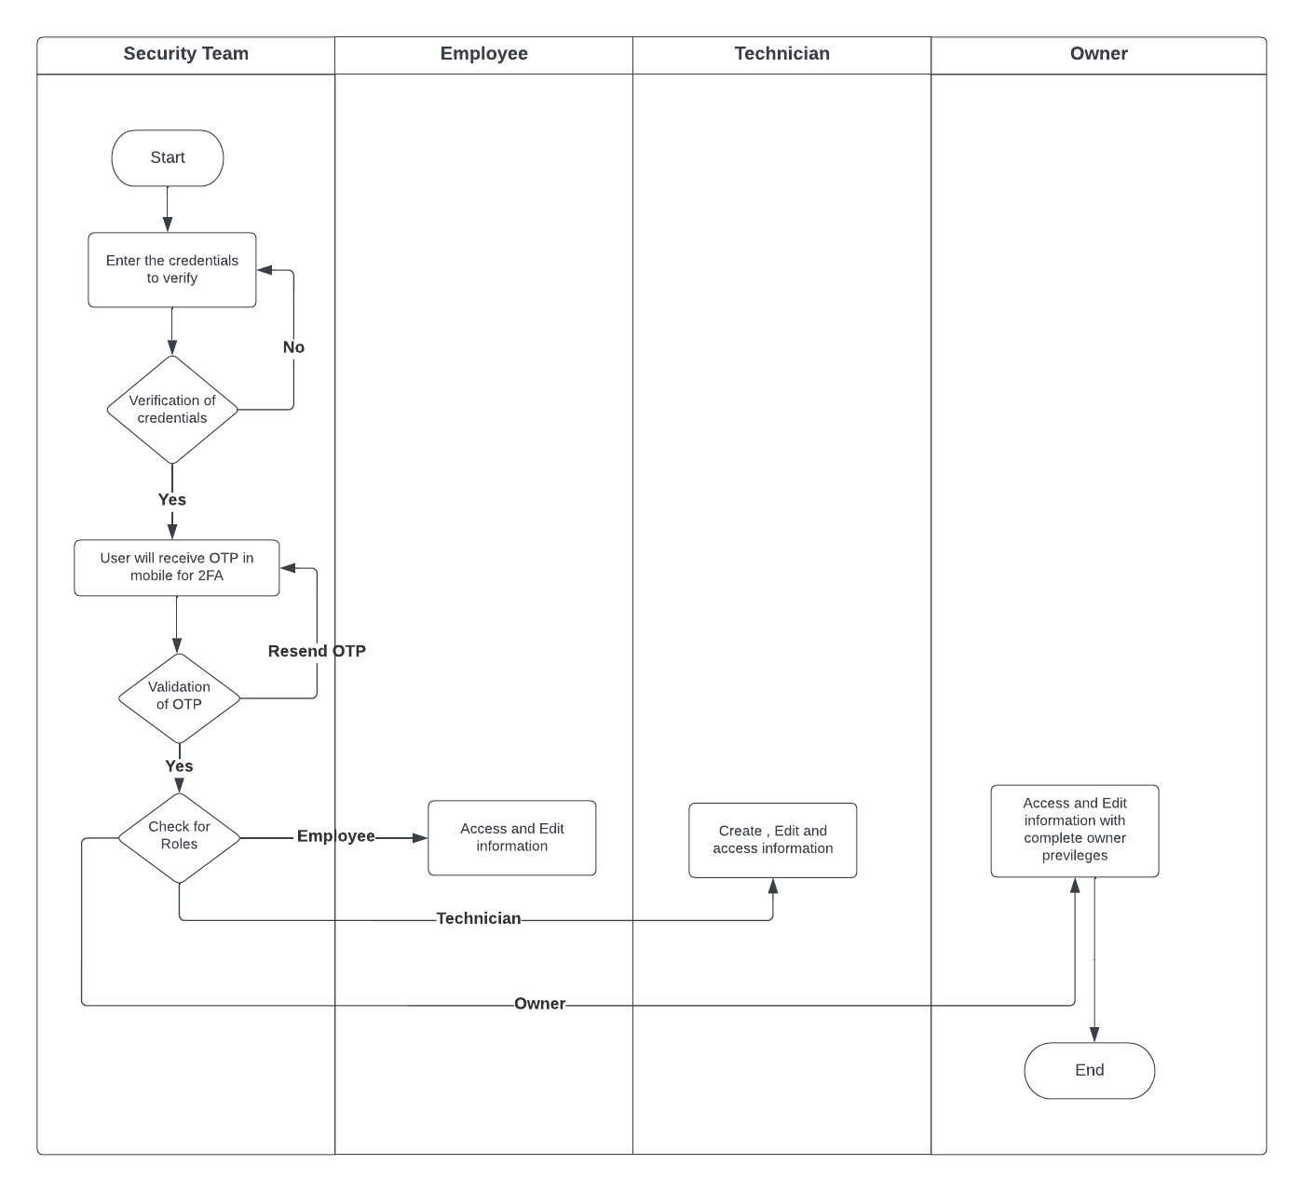
Business Function 4: Security Process
The goal of security management is to maintain high-level security to every function and separate the access of function to various roles based on the stakeholder level of authority.
This is done to ensure that the underlying sensitive data is kept as secure as possible.
Fig.4

Slide 12
SYSTEM DESIGN

Slide 13
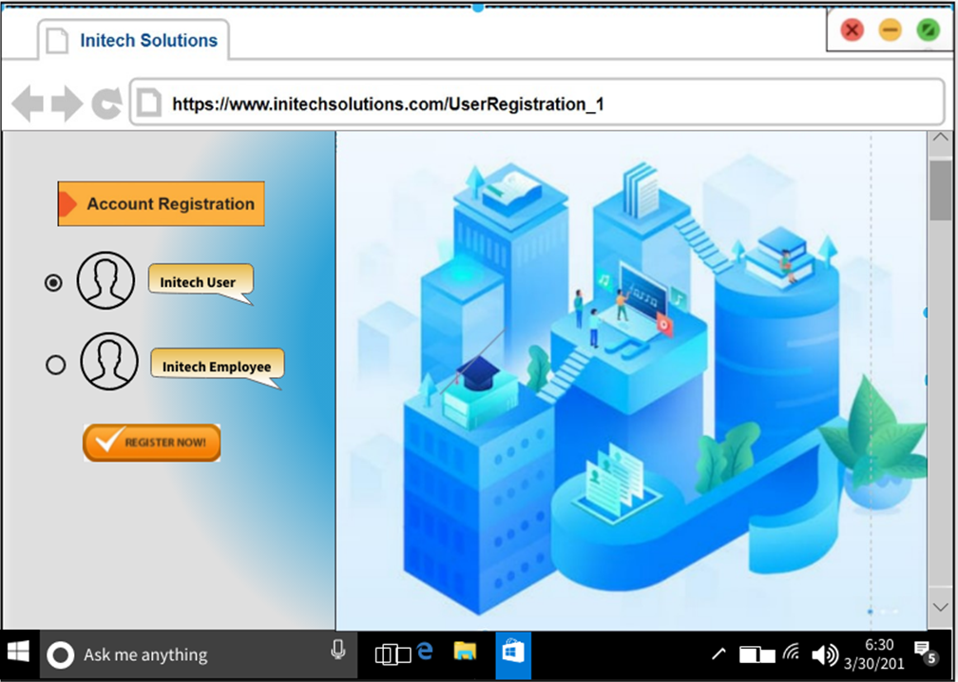
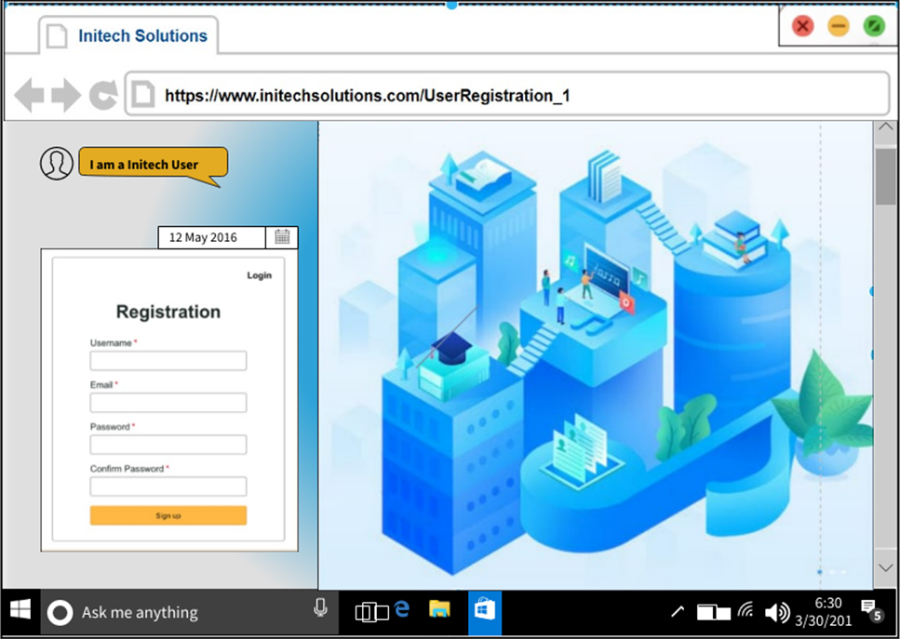
User Interface: Mock-ups
Wireframe 1: Desktop-based GUI for Asset Management System (Security Process)
Initech solution’s account registration page with the option to register as a new Initech user or new Initech employee.
Fig.5
Fig.6

Slide 14
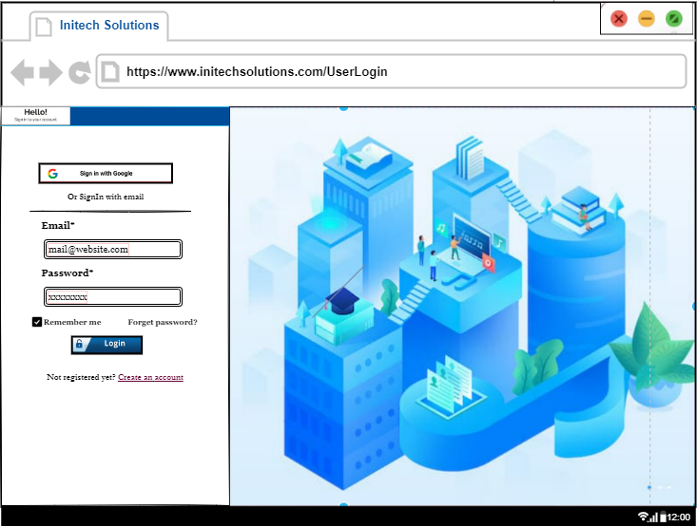
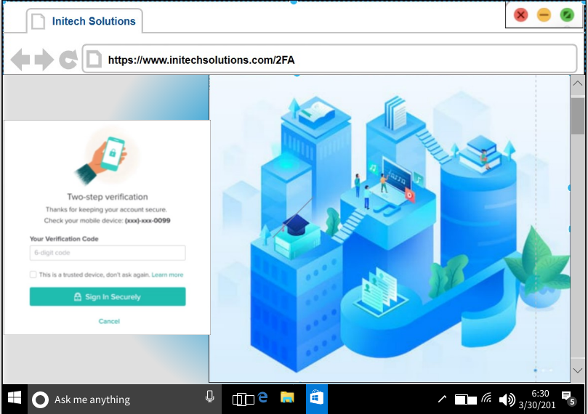
Wireframe 1: Desktop-based GUI for Asset Management System (Security Process)
Every user/employee can access the Initech system by logging in through the user login page, followed by successful two-factor authentication.
Fig.7
Fig.8

Slide 15

Wireframe 1: Desktop-based GUI for Asset Management System (Security Process)
From the Initech solution’s main page, we can navigate to the required sections (asset tracking, stockroom management, ITAM process, security).
Fig.9

Slide 16
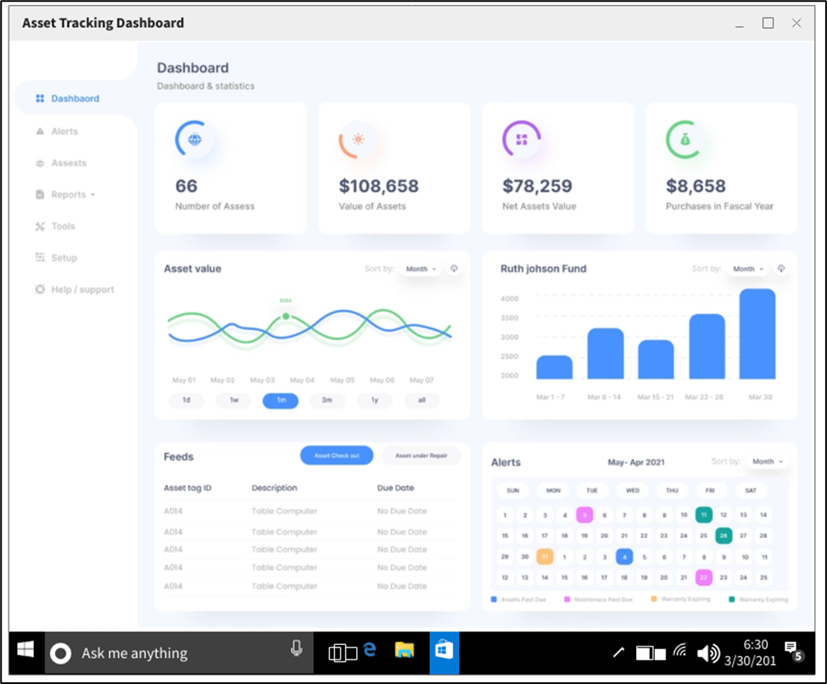
Wireframe 2: Asset Tracking Dashboard
The asset tracking dashboard is a visual representation of the overall information in the serialized asset tracking process.
Fig.10

Slide 17
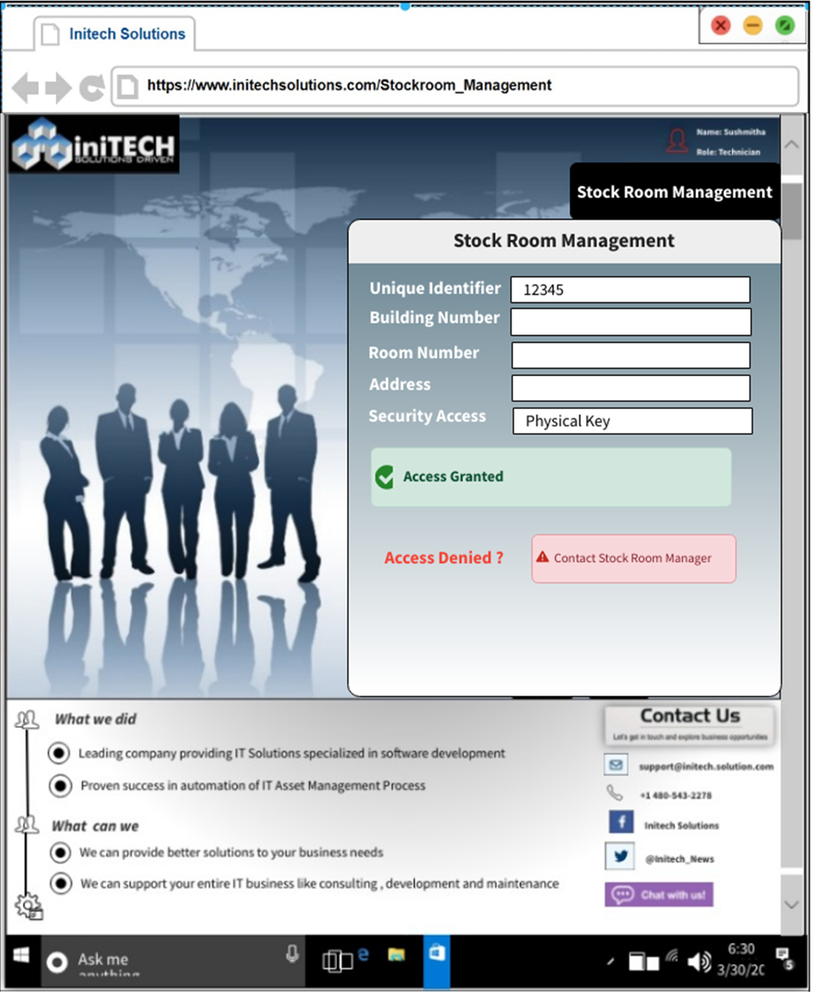
Wireframe 3: Stockroom Management
Gain access to stock rooms by inputting the unique identifier, building number, room number, address of the stockroom, and with the help of security control access (physical key).
Access will be denied if the unique identifier information is inaccurate, or the physical key is not matched
Fig.11

Slide 18

Wireframe 4: ITAM Process – Asset Entry
The asset entry user interface is used to enter asset data into the repository.
Inputs -- asset id, asset name, asset model, asset location, and the details of the person to whom the asset is assigned.
Fig.12

Slide 19
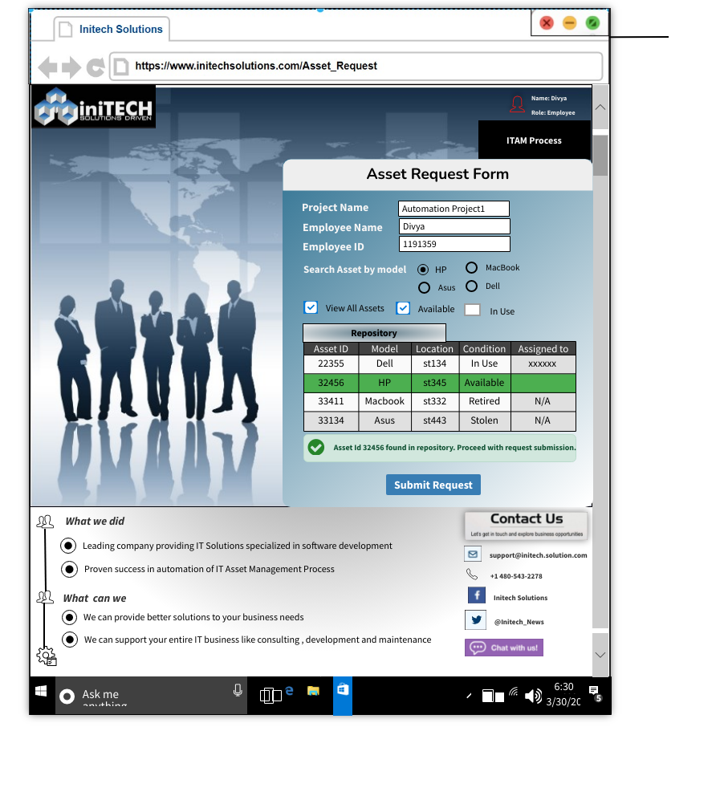
Wireframe 5: ITAM Process – Asset Request
Employees will be able to submit a request to install equipment from a stock room via the request process.
They can utilize the asset request user interface for this purpose.
Fig.13

Slide 20
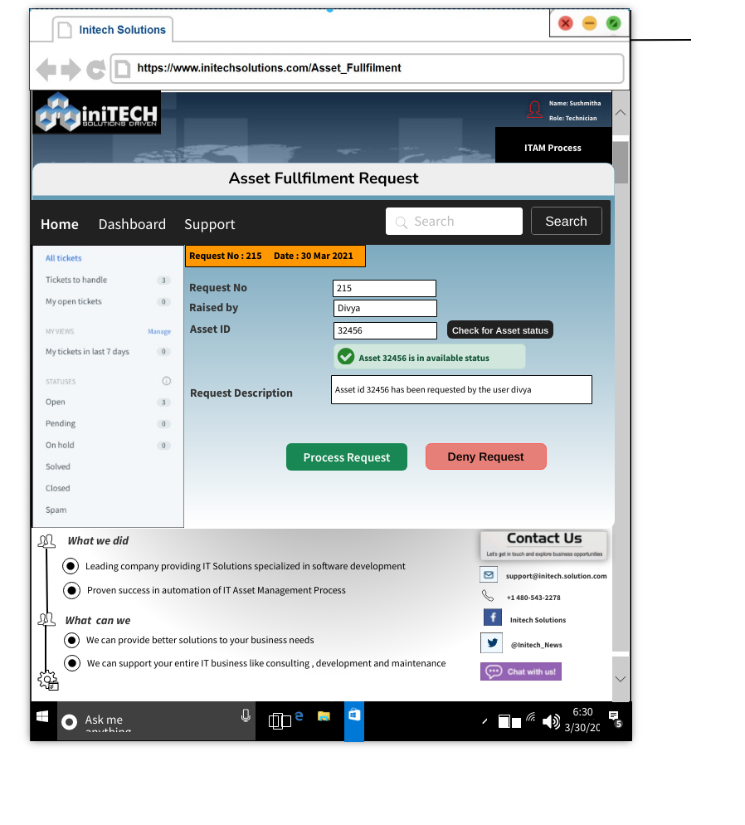
Wireframe 6: ITAM Process – Asset Fulfillment Request
The technicians will be able to handle the asset request via the asset fulfillment user interface.
The technician can view the request details by clicking on the request number, and he also has the authority to verify the asset status prior to processing the request.
Fig.14

Slide 21
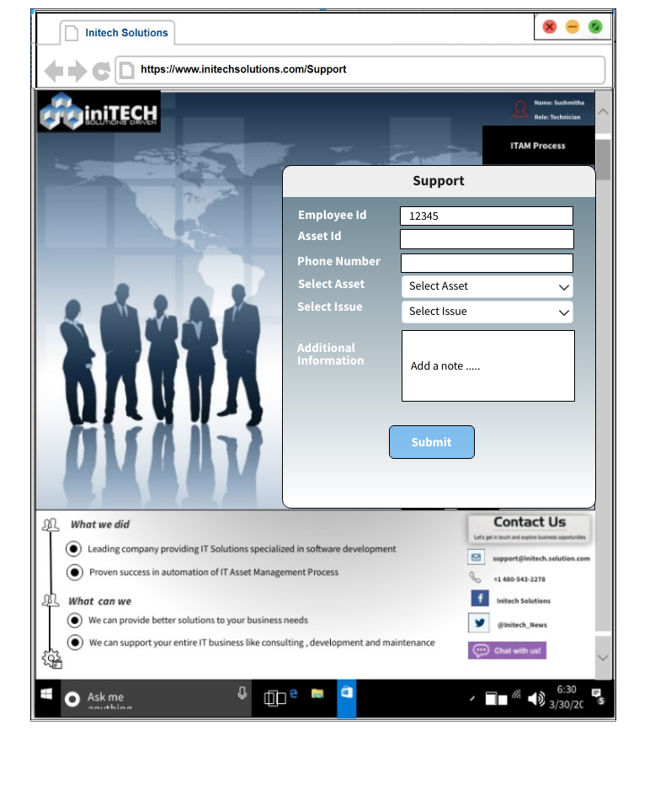
Wireframe 7: ITAM Process – Support
The employee can submit the service requests for the support services like installation of software, replacement of hard drives, or system refresh, through the user interface built for the support process.
Fig.15

Slide 22
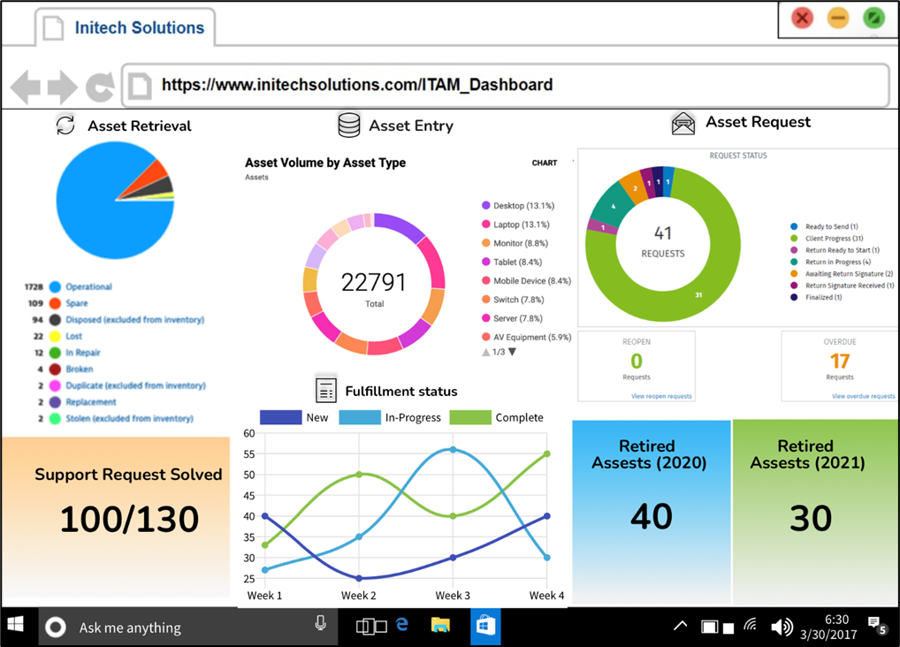
Wireframe 9: ITAM Process Dashboard
Various phases of the ITAM process have been displayed in a single dashboard.
Fig.17

Slide 23
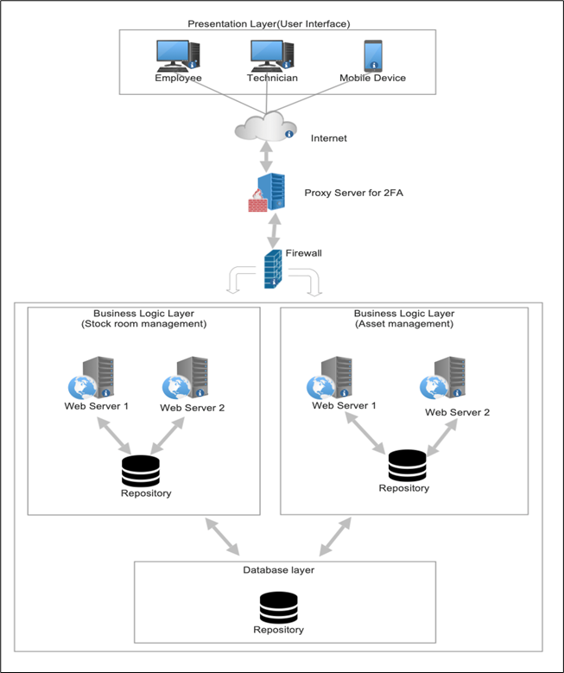
Infrastructure Architecture: Network Topology
Network topology encapsulates all the elements in a network.
The proxy server is used to perform two-factor authentication when a user or employee attempts to access the system.
The Business Logic Layer manages the business rules, calculations, and logic that determines how asset management and tracking should be done.
The database layer contains the repositories that encapsulate the logic required to access data sources.
A firewall is used to keep the organization’s complete network secure.
Fig.18

Slide 24
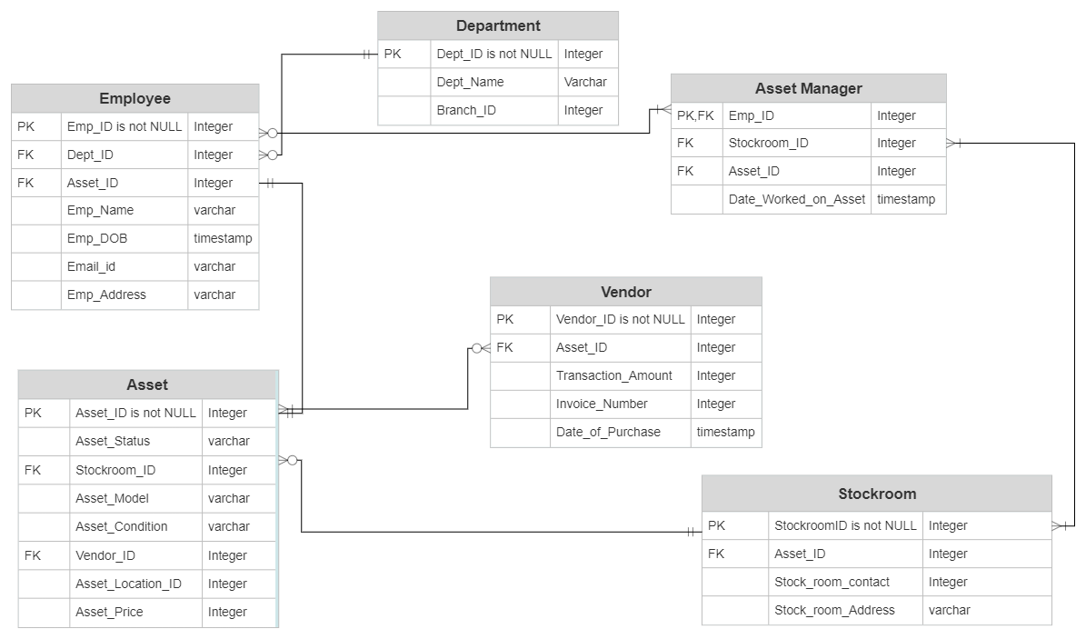
Infrastructure Architecture: ERD
ERD Diagram consists of the below tables:
Employee
Department
Asset Manager
Vendor
Asset
Stockroom
Fig.19

Slide 25
Security and Privacy Architecture
Authentication
Authentication enables organizations to keep their networks secure by permitting only authenticated users or processes to gain access to their protected resources.
Most common form is password-based authentication.
To ensure greater security, an additional authentication factor should be used.
Two-factor authentication includes a unique code generated by the proxy server.
This, combined password-based authentication, will add an extra layer of security

Slide 26
Security and Privacy Architecture
Authorization
Authorization is the procedure through which a server determines if an individual has permission to use a resource or access a file.
For authorization, the system needs role-based access, and control, with attention to the least privileged.
Authorization separates data visibility based on the user’s role.
Physical access control strengthens security during stockroom management.
Risk control procedures help businesses assess losses and eliminate them.

Slide 27
Security and Privacy Architecture
Privacy
Privacy theft can be caused due to negligence, surveillance of competitors, and unsecure systems.
Access control regulations, such as software constraints, are implemented in the enterprise environment in order to maintain security and privacy in the asset management system.
This can be prevented by carefully defined access control regulations.
Stockroom manager must be the only person to manage the hardware of the company.
Protection against attacks can be achieved by constantly scanning for vulnerabilities.

Slide 28

References
Tilley, S. R. (2020). Systems analysis and design. Cengage.
Schwalbe, K. (2019). Information technology project management (9th ed), Boston, MA: Cengage Learning.

